Slide 1
The Partnership for New York City
Advancing New York's standing a global center of economic opportunity, upward mobility and innovation.

Slide 2
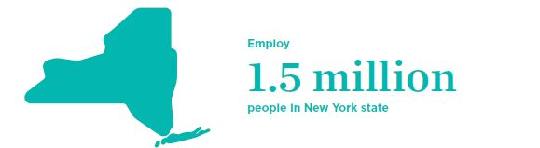
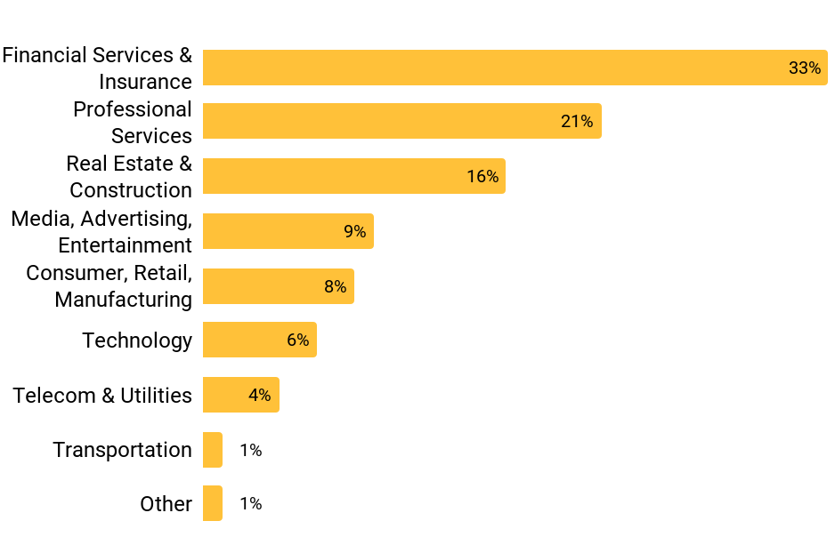
Who we are
330
Members from across business
Members employ
1.5 million
people in New York state
330 members

Slide 3
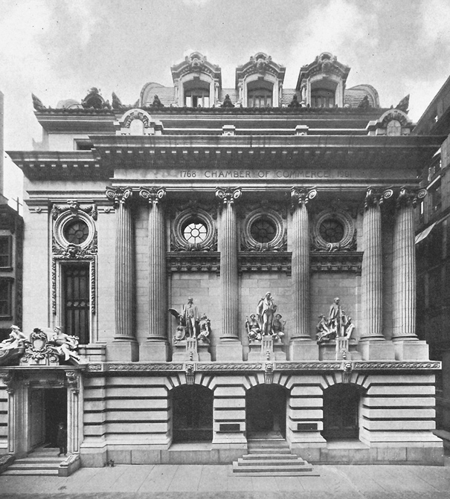
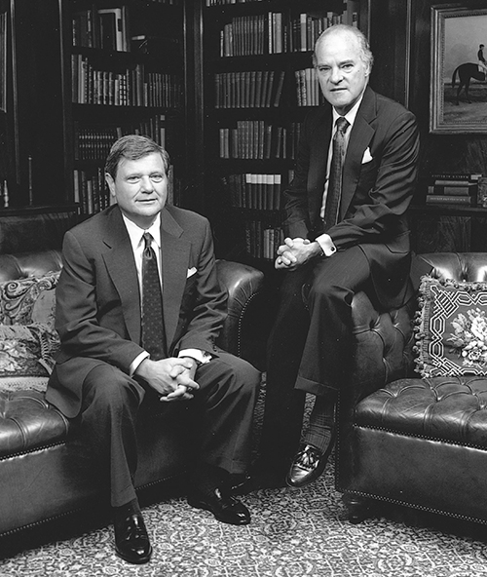
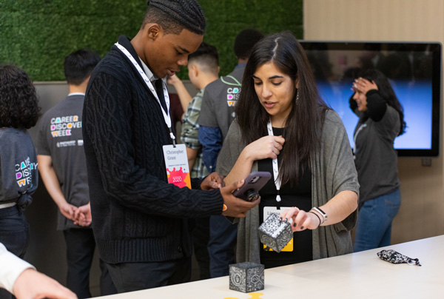
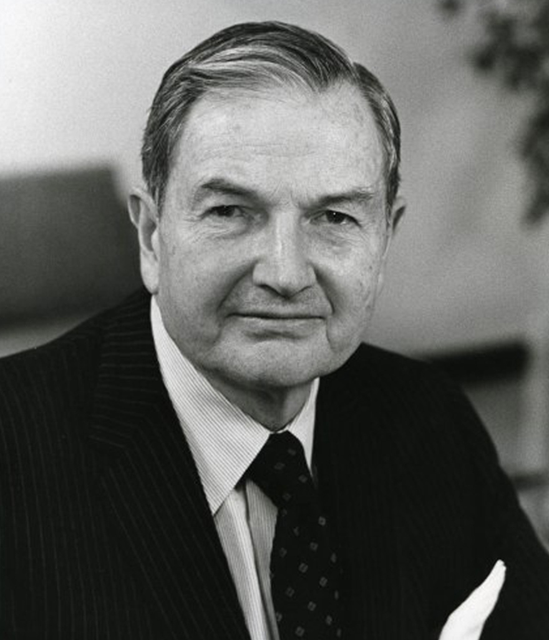
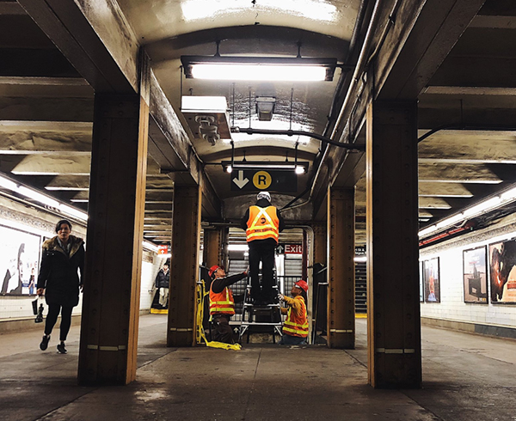
250+ years of advocacy and action
1996
Henry Kravis and Jerry Speyer create the investment fund arm of the Partnership
1768
New York Chamber of Commerce & Industry Established
2020-PRESENT
Navigating COVID-19 through public/private partnership
2007-PRESENT
Leadership in Career & Technical Education (CTE)
1979
David Rockefeller founds the Partnership for New York City
2001
Blueprint for Recovery from 9/11 Terrorist Attacks created
2018-PRESENT
Transit Innovation Partnership

Slide 4
How we work
Integrated approach on
Program activity
Advocacy
Research
Networking
Smart Investments
Government
PFNYC
Academics
Civic Leaders

Slide 5
Where we are
UNEMPLOYMENT RATE
9.8%
September 2021 Down from a peak of 20% in May 2020
JOB POSTINGS
405,000
September 2021 Up 4% from August 2021
WEEKDAY SUBWAY RIDERSHIP
3.2M
Early November 2021 Down 46% from pre-pandemic levels
Notes:
[Unemployment stats]
[Job opening and posting stats]
[Mass transit ridership stats]
[Small business foot traffic stats]

Slide 6
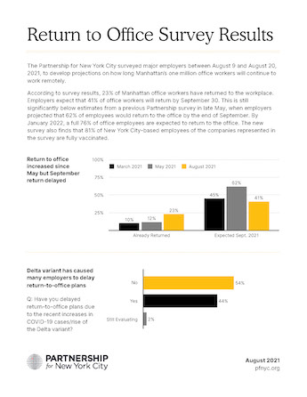
Research and policy
Create resources for public policy makers, the media and the public
Economic impact studies
Business surveys
Convene working groups to provide the public sector with the pro bono expertise
Example Reports
Return to Office Survey (August 2021)
Call to Action Report (June 2020)
Signs of Progress (July 2021)

Slide 7
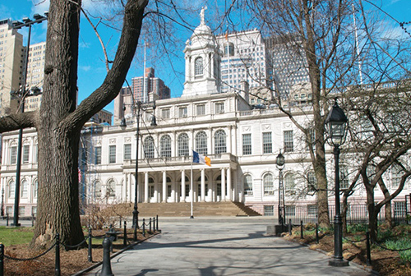
Advocacy and partnerships
Engage in advocacy at the city, state and federal level
Support economic health through public-private partnership

Slide 8
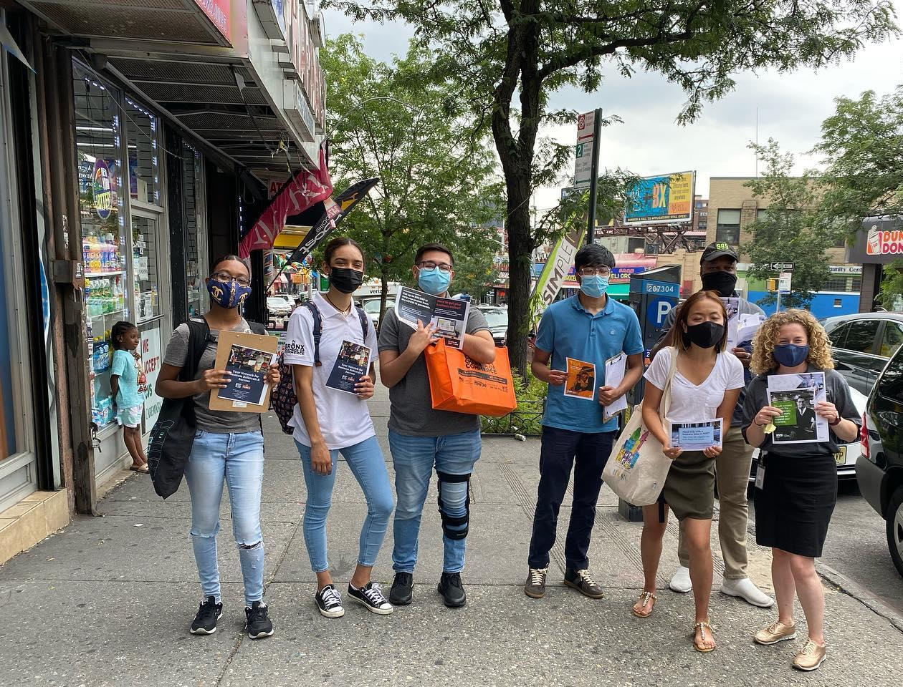
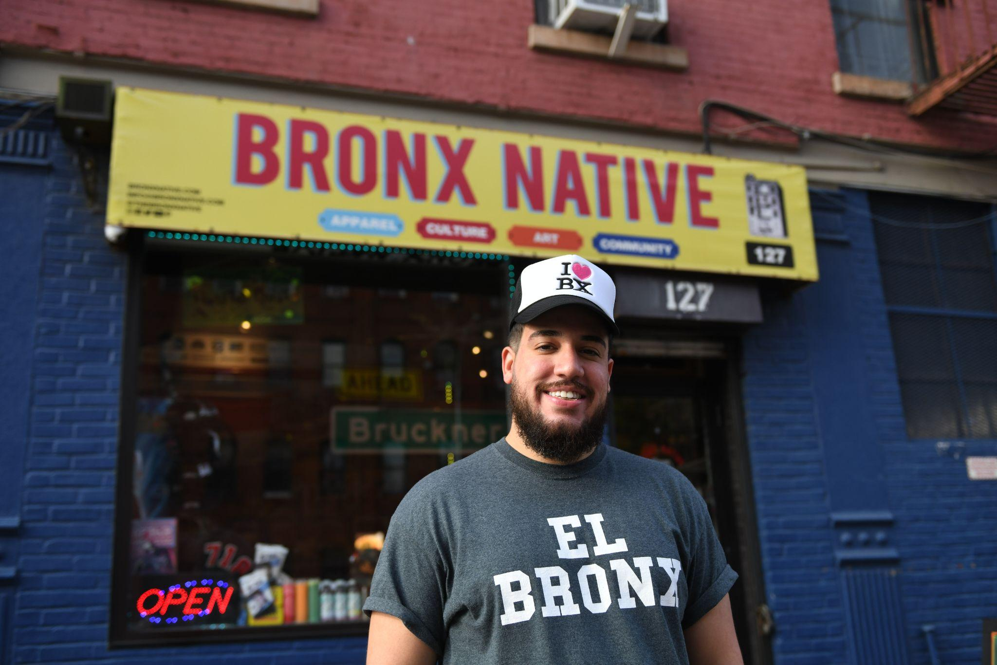
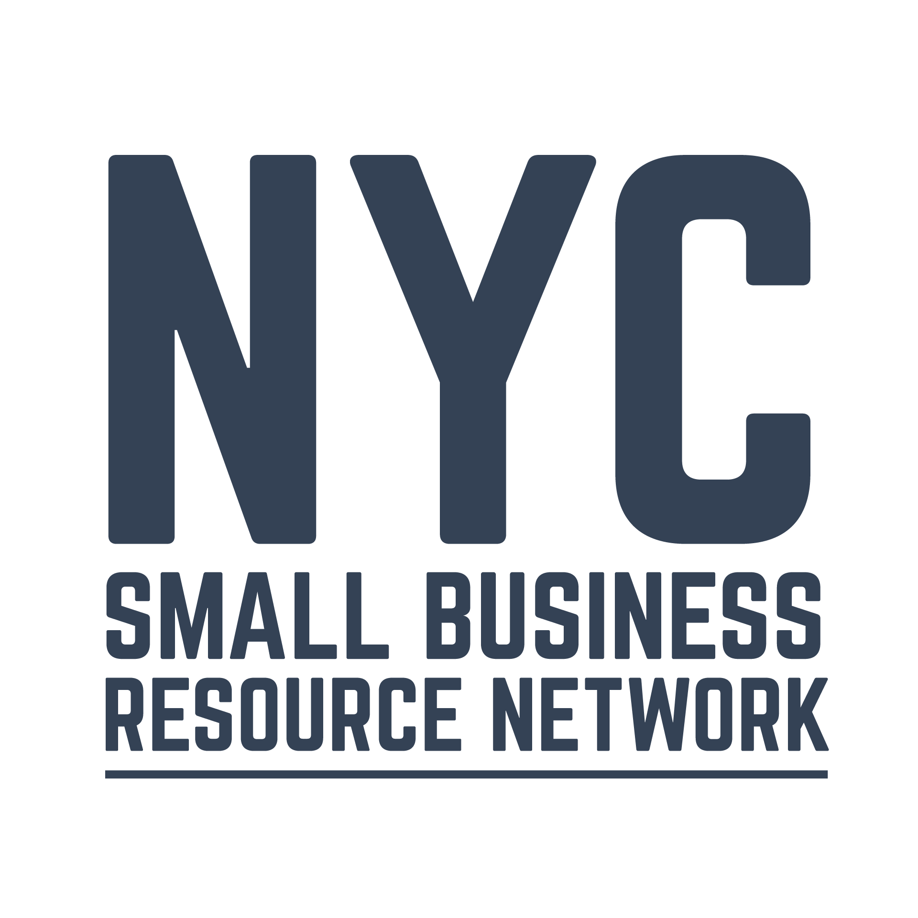
KEY PROGRAMS
Small Business Resource Network
Connecting 20,000+ minority and women-owned small businesses with private and public resources
Open + Online is providing free websites and SEO consultation

Slide 9
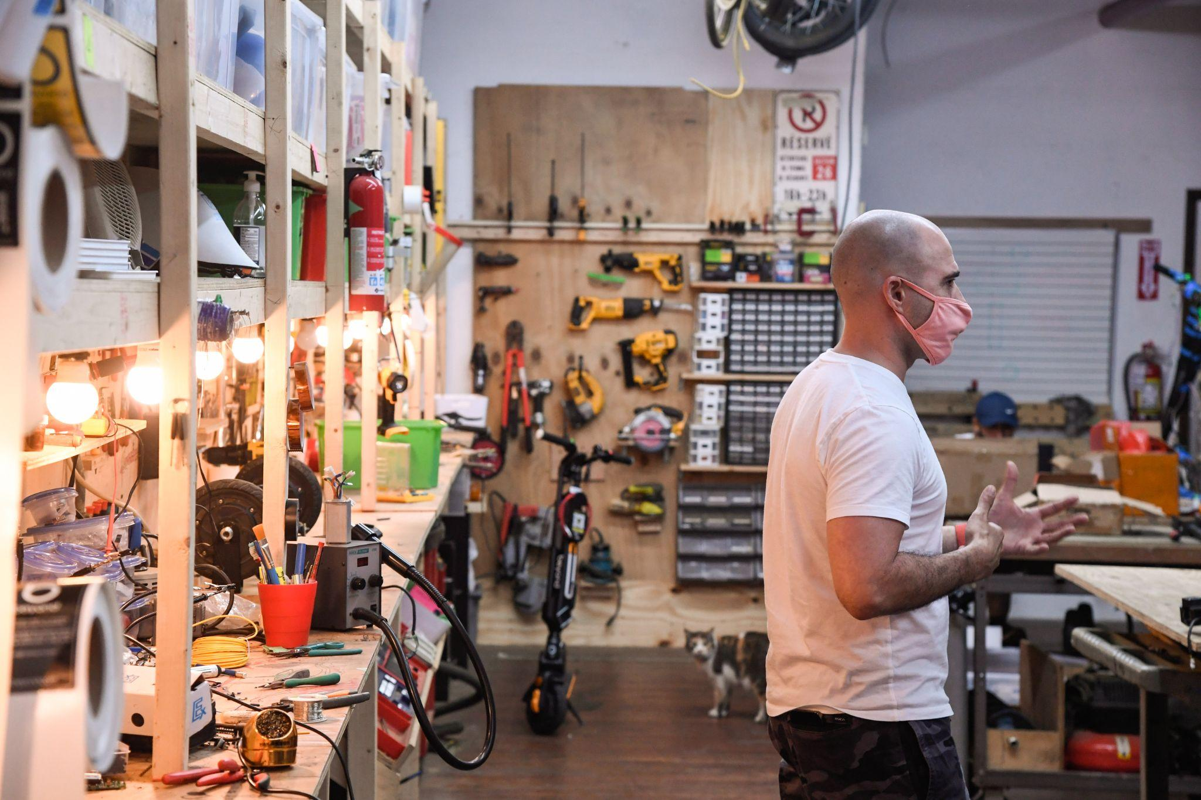
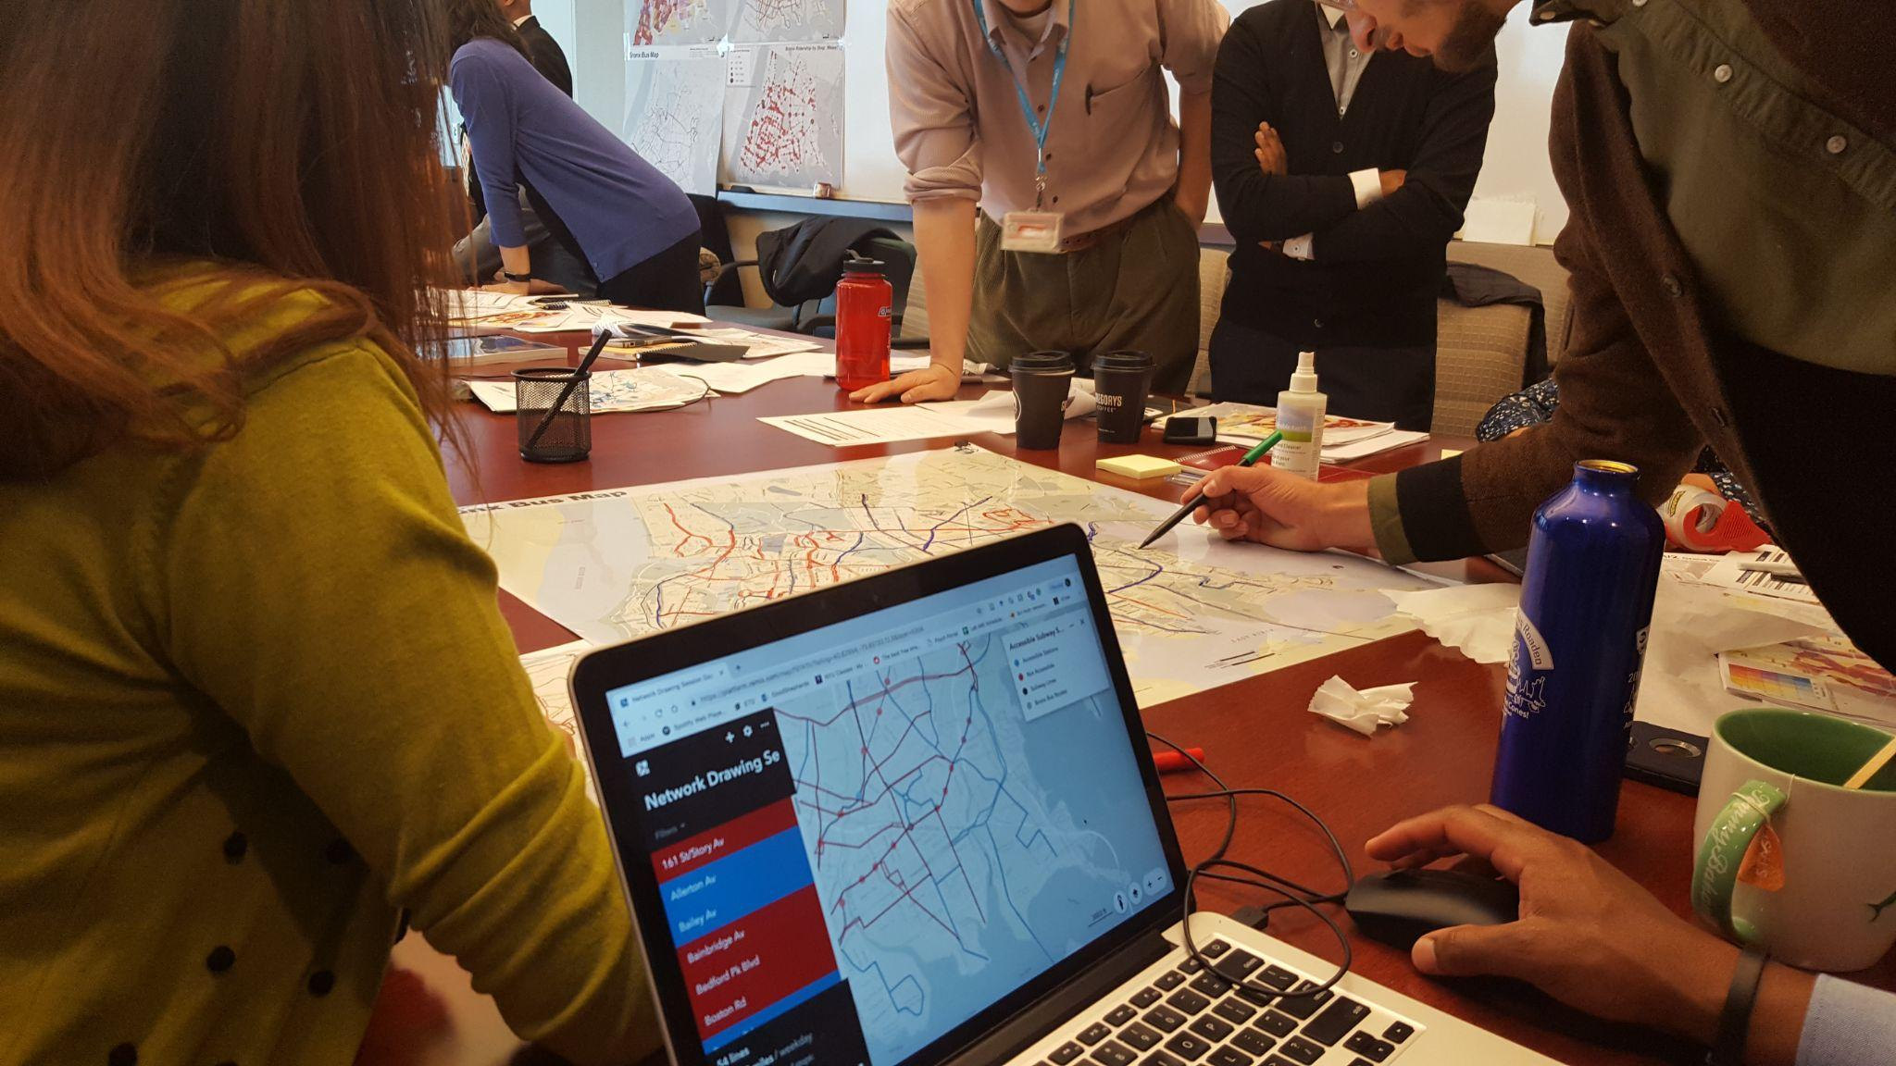
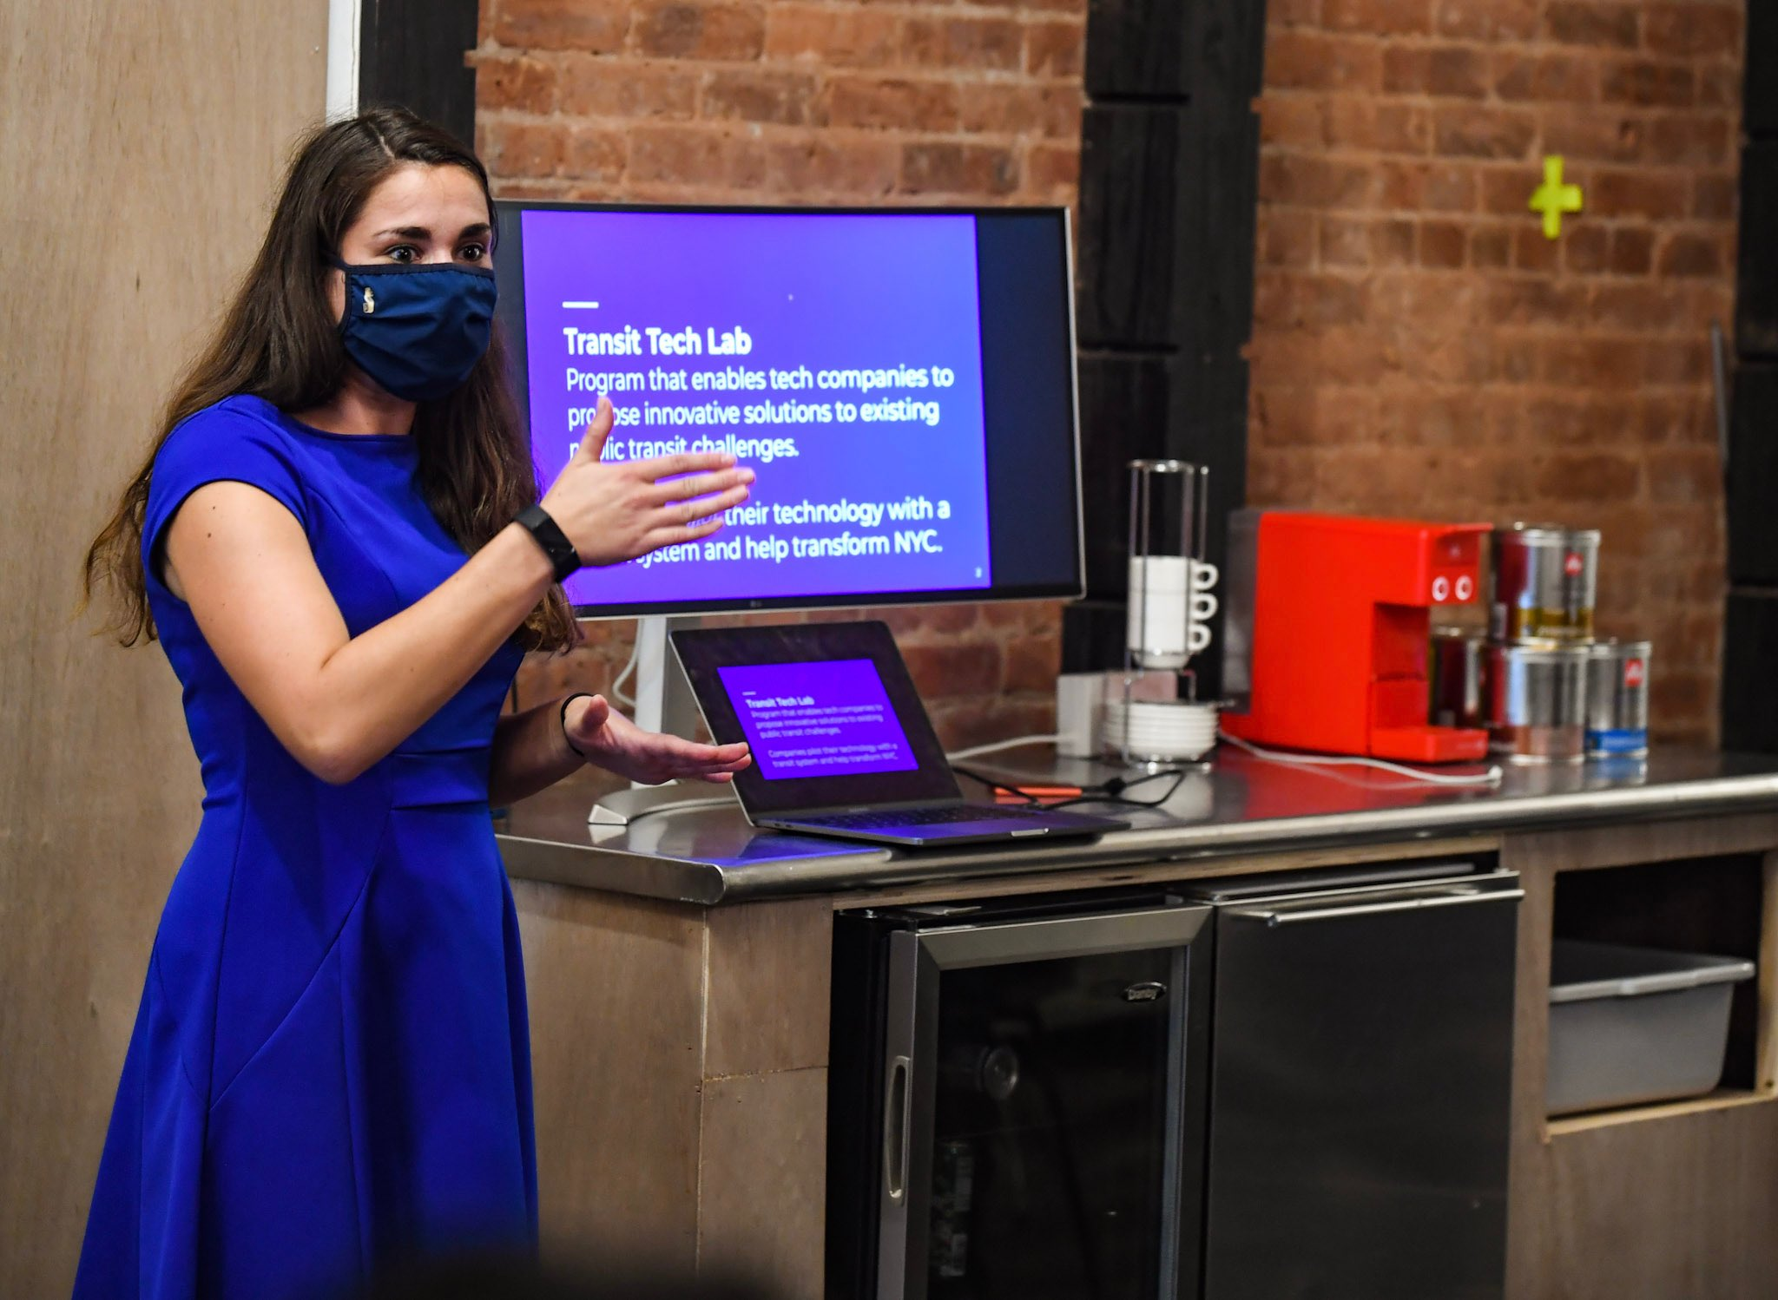
KEY PROGRAMS
Transit Innovation Partnership
Providing private sector and pro bono expertise to the MTA and other public transit agencies
20+ innovation pilots executed through Transit Tech Lab

Slide 10
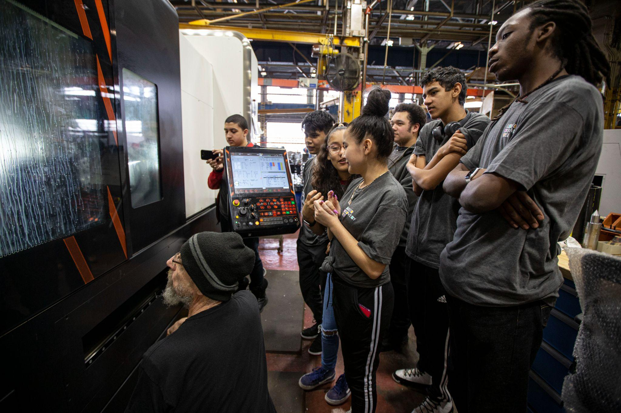
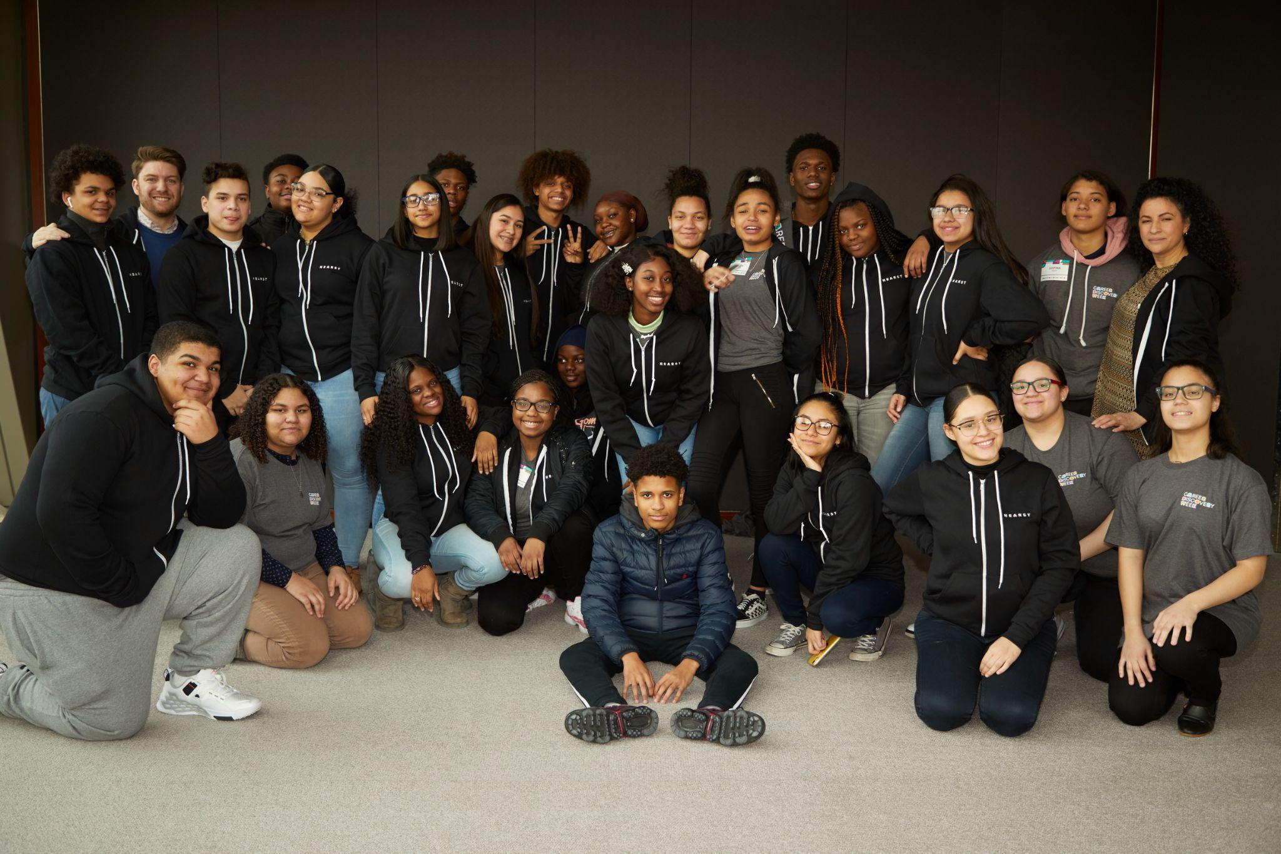
KEY PROGRAMS
Career Discovery Week
Introducing students to NYC employers and professional work settings
6,000+ NYC 10th graders paired with 180 member companies

Slide 11
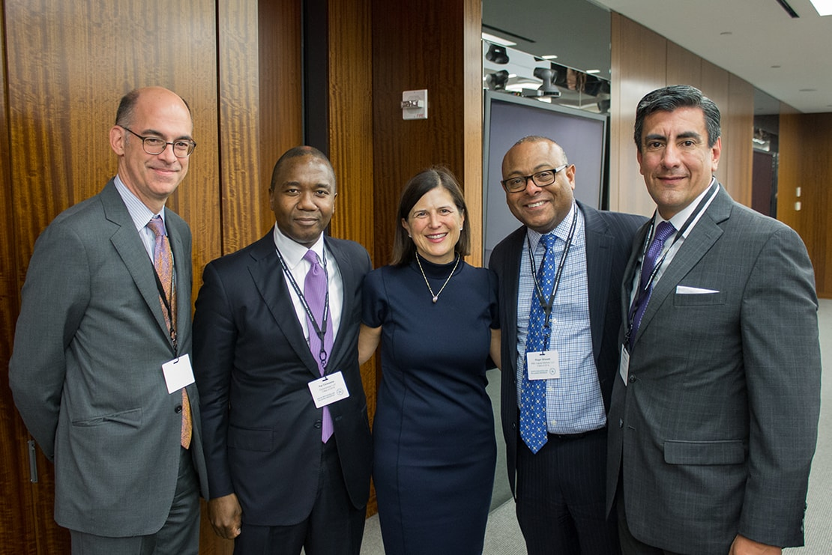
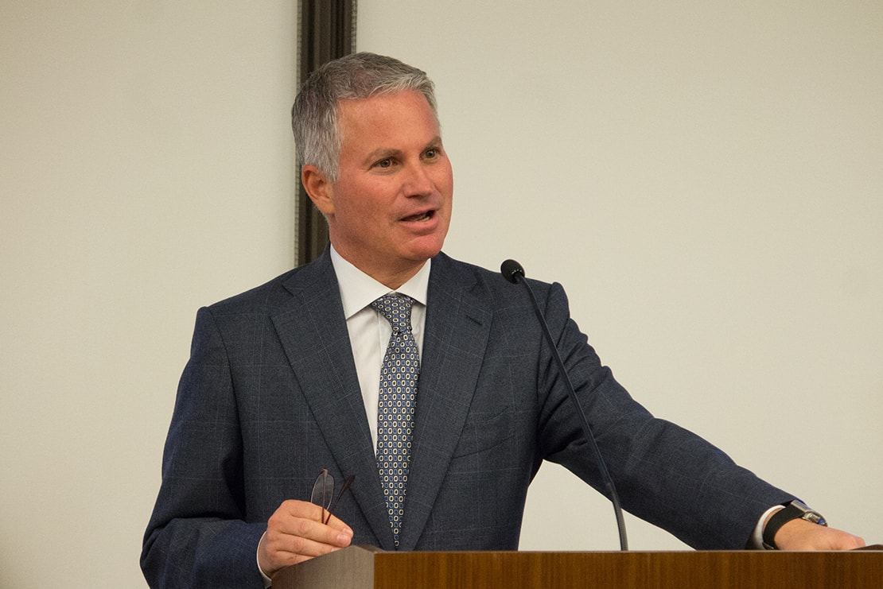
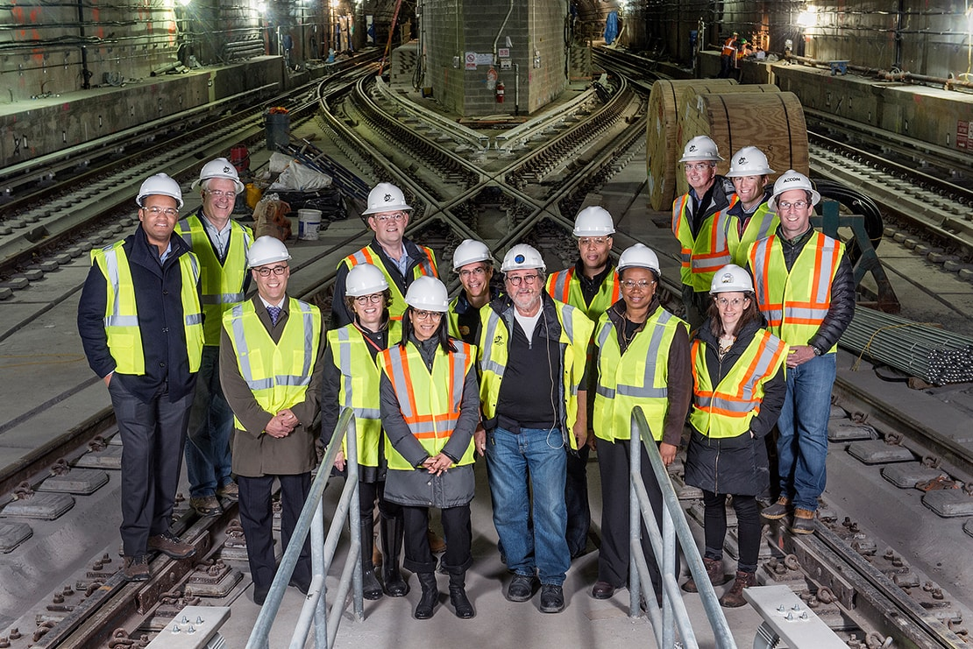
KEY PROGRAMS
David Rockefeller Fellows
Preparing senior corporate executives for more active leadership in civic affairs
450+ senior executive graduates

Slide 12
Partnership Fund for New York City
We invest in New York City-based companies to expand job opportunities and spark innovation in all five boroughs.

Slide 13
About Us
Private Fund with a Civic Mission - focus on double bottom line
Established in 1996 by Henry Kravis and Jerry Speyer to build a stronger and more diversified NYC economy
Capitalized by contributions from 67 individual and corporate investors - $180 million under management
Fund leverages the expertise, resources and relationships of its investors
Economic development and investment arm of the Partnership for New York City

Slide 14
Investors
AT&T Corp.
Bank of America
The Bank of New York Mellon
Leon Black
Blackstone
Bloomberg L.P.
Canadian Imperial Bank of Commerce
Capital One Bank
Russell L. and Judith M. Carson
The Chazen Foundation
Citigroup Inc.
Commerzbank (former investor)
ConEdison, Inc.
Credit Suisse
Deloitte (former investor)
Deutsche Bank
The Estee Lauder Companies, Inc.
Fisher Brothers Foundation
General Electric Company
Golden Family Foundation
Goldman Sachs
Jerome L. Greene
Hearst
HSBC Bank USA
Henry R. Kravis
Loews Corporation
Macy’s, Inc.
Magellan Health Services
Marsh & McLennan Companies, Inc.
MetLife, Inc.
JPMorgan Chase & Co.
Morgan Stanley
National Grid
New York Life Insurance Company
Pfizer, Inc.
Lionel I. Pincus
R.J. Reynolds
The Reader’s Digest Association
Joseph H. Reich
Rentpath
Julian Robertson
David Rockefeller
Susan and Elihu Rose Foundation
Rudin Family
Simpson Thacher & Bartlett LLP
Sovereign Bank
Jerry I. Speyer
Thomson Reuters
TIAA
Tiffany & Co.
UBS
Verizon Communications
ViacomCBS, Inc.
Vivendi
Wachtell, Lipton, Rosen & Katz
The Walt Disney Company
Albert Waxman

Slide 15
Investment Principles
Expanding Opportunity
for under-served populations and to support minority- and women-owned companies
$76mm
invested
Promote Public Sector Innovation
Leveraging private sector resources and expertise to promote city innovation and sustainability and to support growth in new sectors
$45mm
invested
Sparking Innovation
Seeding in emerging tech sectors including fintech, health IT, life sciences, and advanced manufacturing
$62mm
invested

Slide 16
Catalytic Activities
In addition to investments in individual projects, the Fund also:
Operates two tech accelerator programs in fintech and transit tech
Works in partnership with local government to catalyze the growth of new sectors, such as life sciences and quantum computing
Establishes special purpose programs to deal with significant civic issues, such as the 9/11 attacks and COVID-19 economic shutdown

Slide 17
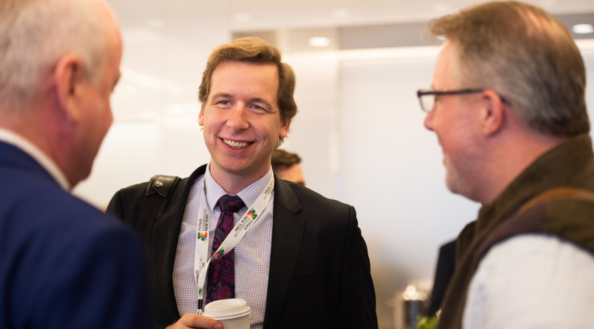
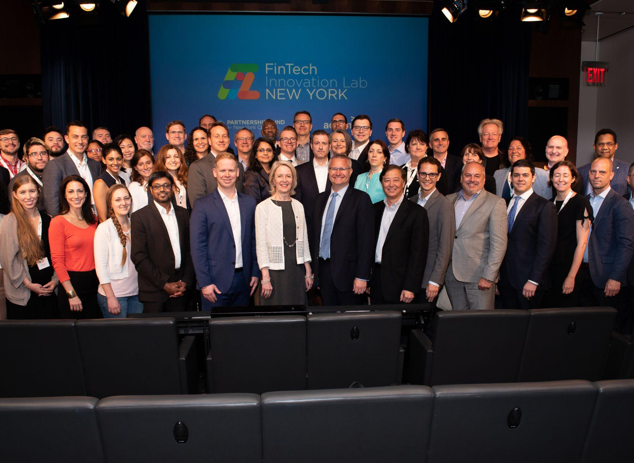
FinTech Innovation Lab
3-month program for tech companies developing products for financial institutions
44 major financial institutions as partners
79 graduates, including Digital Asset, Enigma, Kasisto, Pymetrics
278 pilots conducted by Alumni
1,300+ jobs created
$1.6B raised post-program by graduates
Partnered with Accenture

Slide 18
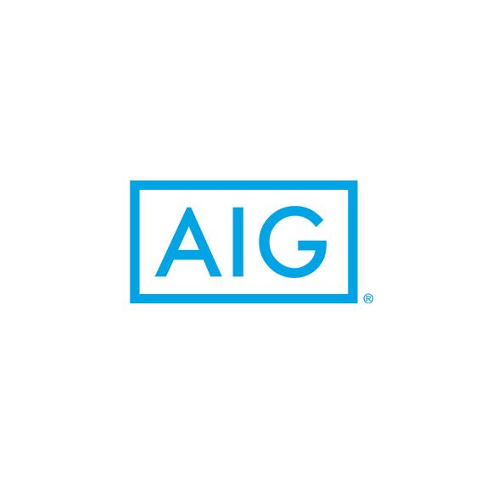
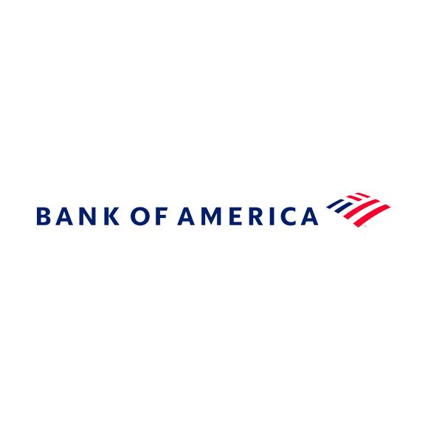
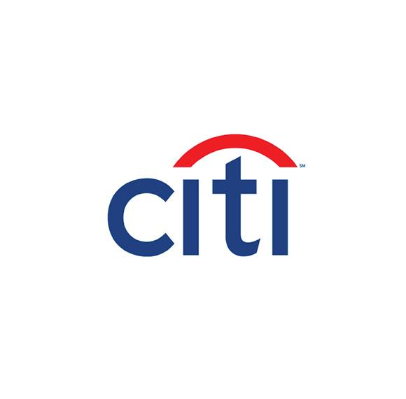
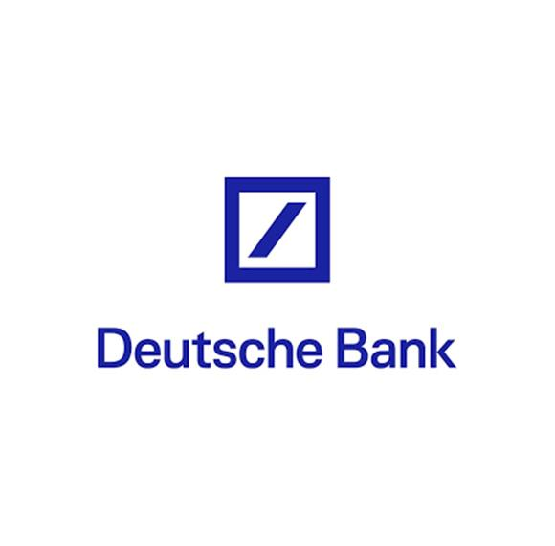
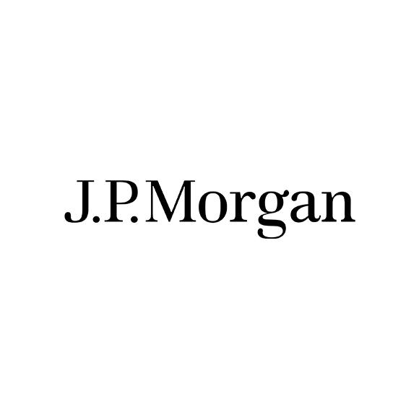
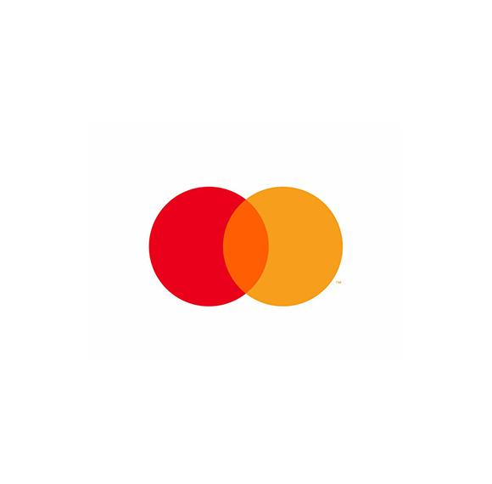
FinTech Innovation Lab Select Partners

Slide 19
Fund Catalyzed $1.5B Public Sector Commitment to Life Sciences
$320mm
Support of life science companies
$200mm of tax incentives for life science companies and angel investors
$120mm matching investment capital for early-stage life science companies
$1.2B
Subsidy for wet lab space
$210mm of capital grants for lab space, incubators and manufacturing facilities
$470mm of capital grants for nonprofit biomedical institutions $450mm in NYC
$500mm of tax incentives for commercial wet lab space developers NYC only
$24mm
Workforce development
and other programmatic
Internships
Training and mentor programs
Business plan competition/accelerator

Slide 20
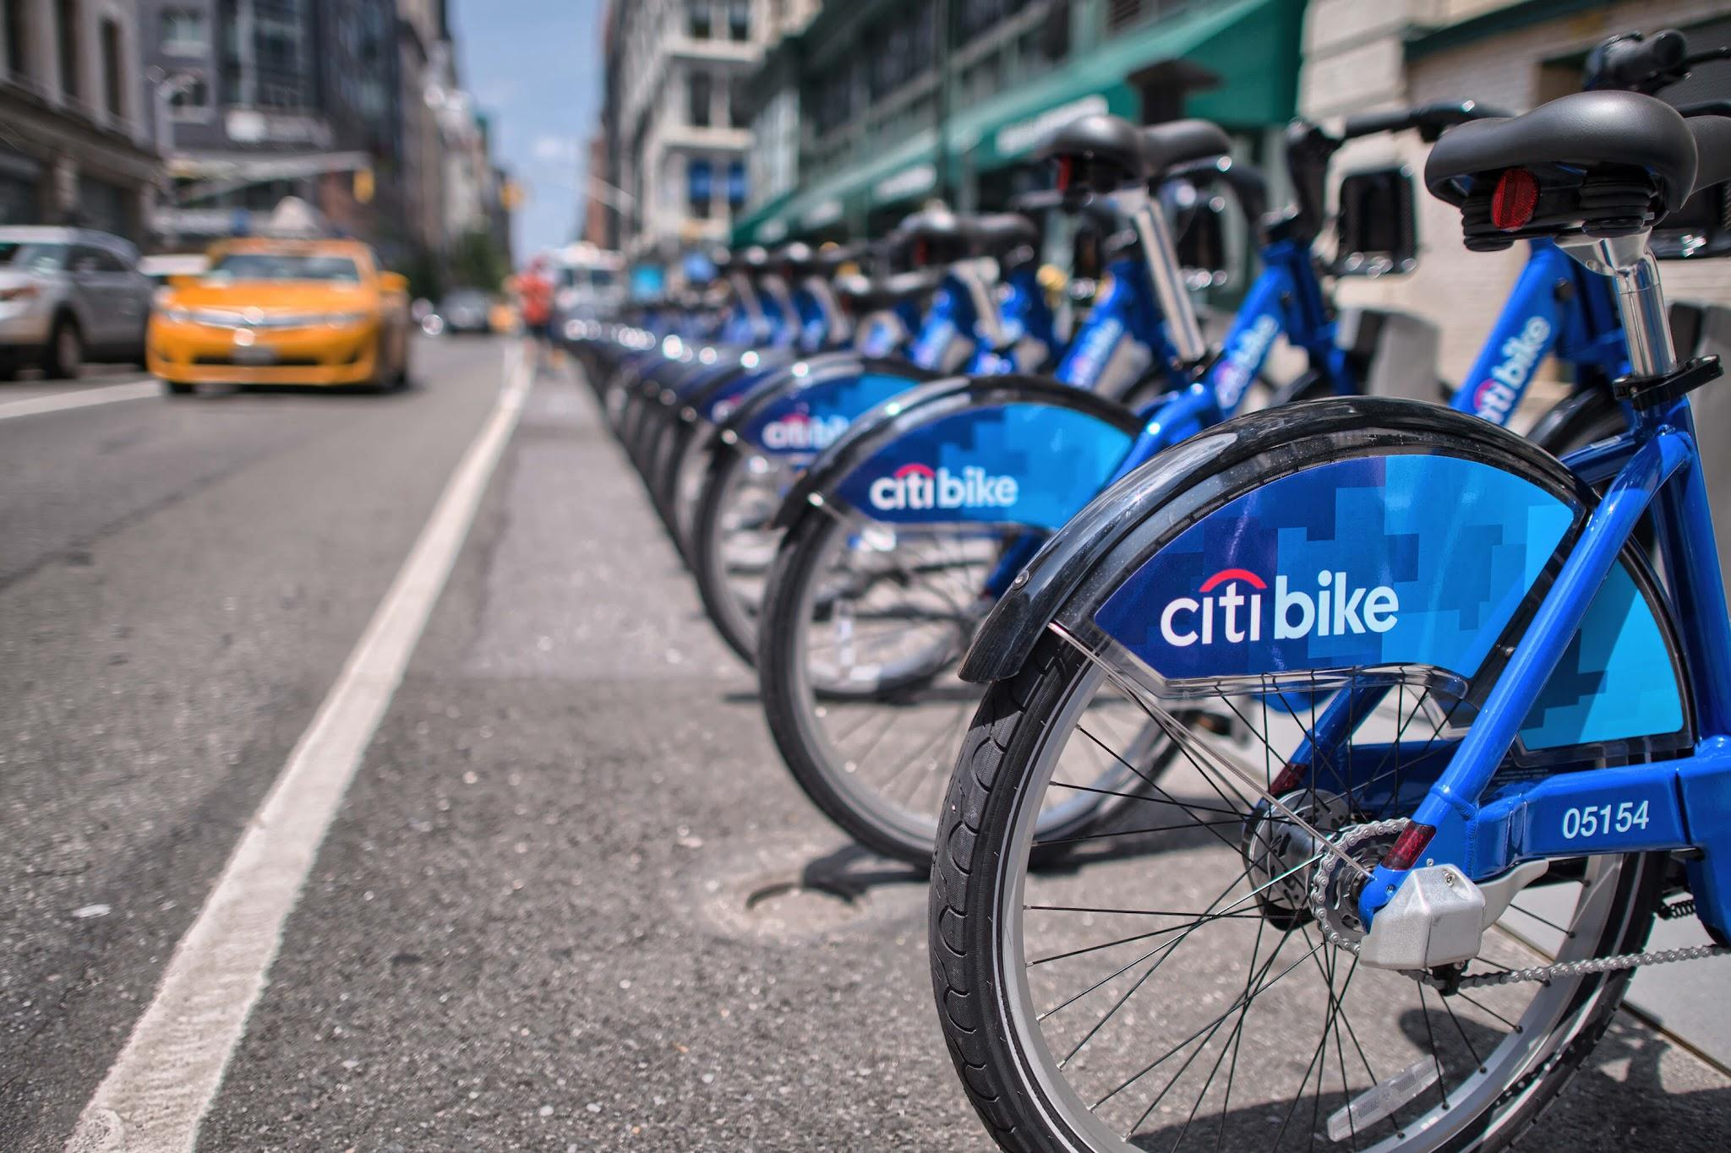
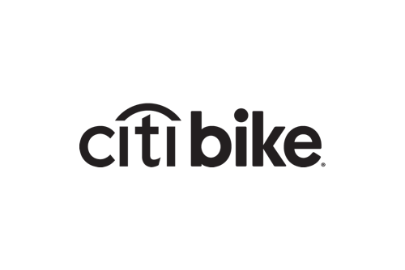
Citi Bike
ABOUT
New York City’s bike share system, and the largest in the nation
FUND INVESTMENT
$5mm subordinated debt
OUTCOME
Supported public sector innovation
Expanded system to underserved communities, such as Harlem and Bedford-Stuyvesant

Slide 21
Newlab
ABOUT
Co-working space focused on hardware technology & advanced manufacturing
84,000 sq. ft. in the Brooklyn Navy Yard
FUND INVESTMENT
Three loans totaling $9mm
OUTCOME
Seeding a new growth industry for NYC
90% leased within 12 months
Burgeoning medical device, artificial intelligence & quantum computing cluster

